Slide 1

Predicting the Potential of players in FIFA 19

Slide 2
Predicting the player potential
After end of each season, football clubs buy and sell players during the transfer window.
The clubs need to be sure about the potential of the player they want to bring in.
Predicting the potential of player based on attributes such as Strength, Stamina, dribbling, international reputation can be of great use the clubs and their scouting teams.
Potential Prediction can be of interest to Betting agencies and fans playing fantasy football as well.

Slide 3
Data Source and wrangling
Data source: Kaggle FIFA 19 dataset
Data contains attributes such as Name, age, nationality, wage, preferred foot, work rate, position, dribbling, free-kick accuracy, etc.
Unnecessary features were discarded. The missing values were replaced with the mean of the attribute.
The cleaned dataset has 18207 rows and 13 features.

Slide 4
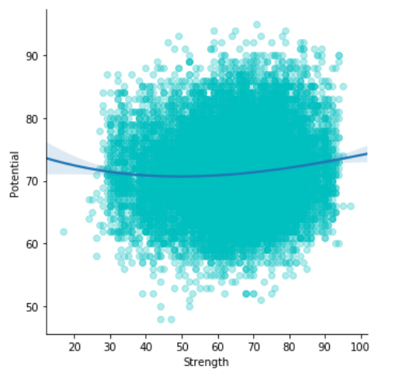
Data Analysis
The ‘Potential’ was chosen as the target variable, while the attribute ‘Strength’ was chosen as the independent variable.
The scatter plot shows the relationship between Potential and Strength.

Slide 5

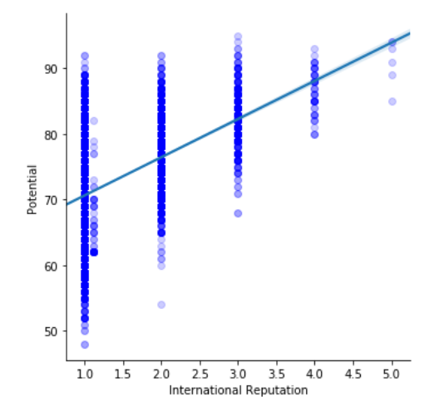
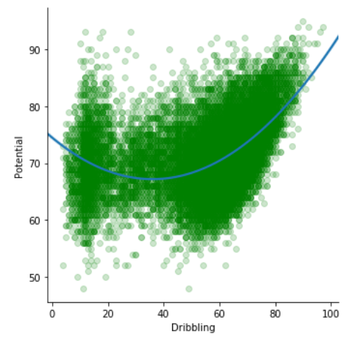
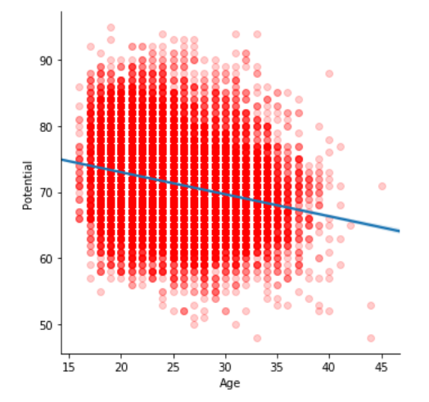
Potential relation to other attributes
Potential & Age Potential & International Reputation Potential & Dribbling

Slide 6
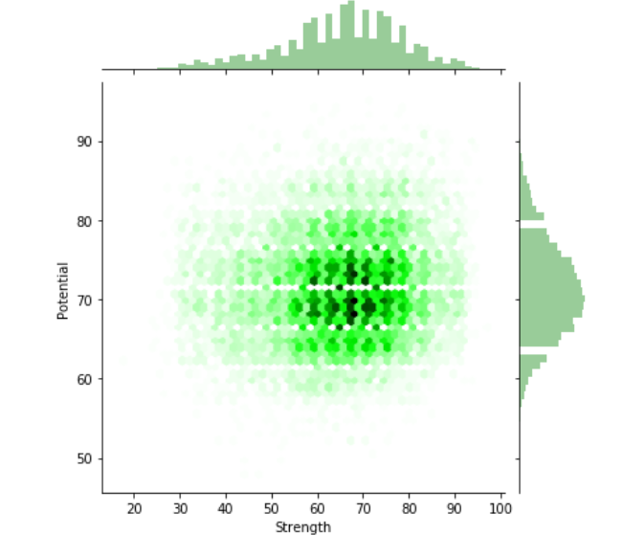
Linear regression Model
Strength: Independent variable
Potential: target Variable
Intercept | 69.00139693
Coefficient | 0.03534763
Mean Squared Error | 37.94121956223381

Slide 7
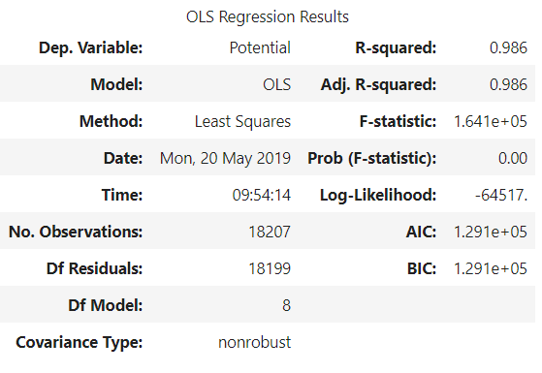
Multiple Regression Model
Independent Variables | Target Variable
1 International Reputation 2 Stamina 3 Strength 4 Aggression 5 Composure 6 Ball Control 7 Dribbling 8 Acceleration | Potential
8 independent variables as shown in the table.
Adjusted R-Squared shows 98.6 % variables are explained in the dependent variable.

Slide 8
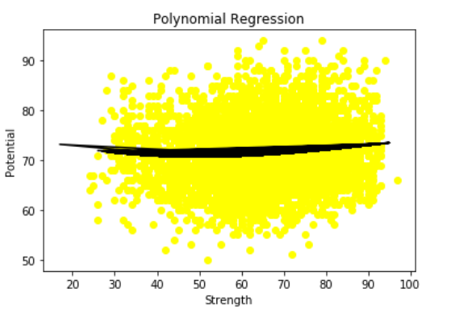
Polynomial Regression Model
Predicting the potential of the player using Polynomial regression (degree=3)
Mean Squared Error: 36.16809096502103

Slide 9
Conclusion & Future Scope
MSE of Polynomial Regression is less than that of Simple Linear Regression.
Therefore, Polynomial Regression provides more accurate results.
The Predicted Potential can be clustered in different categories such as special(>95), exciting(between 90 and 94, etc.

